Slide 1
AI and Games
唐平中
清华大学

Slide 2
What is game theory?

Slide 3
Game theory
Decision making by multiple, selfish agents
Single-agent decision making = AI
Maximize utility given belief
Multi-agent decision making = Game Theory
Maximize utility given belief and decisions by the others
Collaboration and competition
Themes
How to formulate multi-player interactions
Modeling
How rational agents should (would) behave
Prescription and prediction
How to incentivize rational agents to well behave
Design

Slide 4
Computer science and game theory
Fact: John von Neumann
Founder of computer science
Founder of game theory
Game theory deeply interacts with computer science
Theoretical computer science: algorithmic game theory
AI: multiagent systems, game playing, human-robot interaction, machine learning, internet advertising
Half of the Computer and Thought Award winners
Web and Internet: internet economics, sharing economics
Distributed system: Blockchain

Slide 5
2 Major research tracks at the interface of AI and Game theory

Slide 6
Track #1: Computing solution concepts (aka., Optimize game strategies aka., how to play a game)

Slide 7
Track #1
Computing solution concepts
Motivation
Game theory provides models and solutions in various situations
Given standard game-theoretical assumptions, it is the opt solution
Main Problem
Can these solutions be computed efficiently?
Examples
Nash equilibrium in zero-sum game (John von Neuman, 1928)
Polynomial time via linear programing
Nash equilibrium in general sum game
PPAD hard, Lemke-Howson algorithm, (Chen and Deng, FOCS-06, best paper)
PPAD hard to approximate, (Rubinstein, STOC-16, best paper)
Nash equilibrium in Large extensive-form, incomplete information game
Tree search via CFR algorithm (Bowling, 2015, Science)
Game tree abstract (Sandholm, 2015, Science)
Beating top human players in Poker (NIPS 2017, best paper)
Correlated equilibrium (Jiang-Leyton Brown, EC-11 best student paper)
Notes:
No regret learning: http://theory.stanford.edu/~tim/f13/l/l17.pdf

Slide 8
Track #1: Computing equilibrium in large, extensive-form imperfect-info games
[Sandholm, Science 2015]

Slide 9
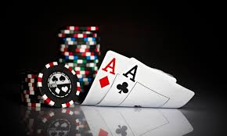
Track #1: Beating top human players in 2-player Texas Hold’em Poker
Winning algorithms/strategies
Abstraction: group nodes and actions by similarity
Compute Nash in abstracted game (CFR)
Extend abstracted Nash to the original game
End-game solving (Brown and Sandholm, NIP-17)
Safe Exploitation (Ganzfried and Sandholm, EC-16)
Texas Hold’em
AAAI annual competition on Computer Poker
Best teams: CMU, Alberta
Recent events of human vs CMU Robot
Libratus, 冷扑大师

Slide 10
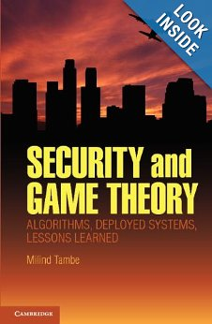
Track #1: Computing Stackelberg equilibrium
Computing optimal commitment
Timing:
player 1 commits to a strategy, player 2 best reacts to this
Why doing so?
Problem: find the optimal commitment for player 1?
Nash equilibrium is a commit, but not optimal
Can be solved by a series of linear programs
[Conitzer&Sandholm, EC-06]
Enumerate the follower’s best response
Application to security (Airport, Border)
10 gates, 5 policemen
What is the optimal patrolling strategy?

Slide 11
Track#1: Learning in games
Problem:
Optimize strategies using self-play or past interactions
Typically via iterations
Major progress
Deep reinforcement learning
Examples:
Atari games [Silver et. al , Nature 2014]
Beating top human players in Go
AlphaGo, AlphaGo Zero [Silver et. al, Nature 2015, 2016…]
Facebook: 6M USD computing resourced to replicate AlphaGo zero
Dota2: recent TI8 matches
Starcraft2: Lambda progresses
2-player poker: Deepstack (Alberta Team)
6-Player Poker: open, with or without learning?

Slide 12
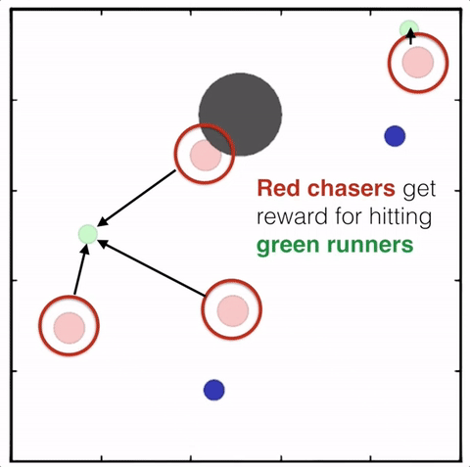
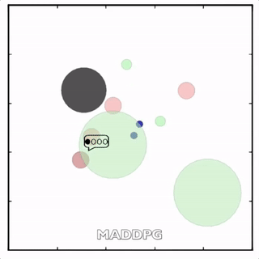
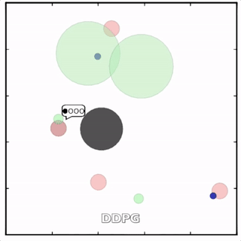
Example: MADDPG [Lowe, et. al. NIPS2017]

Slide 13
Track #1
Our work within this Track – bounded rationality
Compute optimal automata to commit to (AAAI-15)
Repeated games, automata formulation
Compute best response Turing machine (AAMAS-15)
Repeated games, time/space restricted Turing machine
Complexity of K-implementation (AAMAS-16)
Optimal implementation cost to modify an existing game
A 10-year open problem in AI
Bounded rationality strategy (AAAI-17)
K-Memory strategy (AAMAS-17)
Can remember the previous k-rounds
Learning the optimal strategy to commit to (AAAI-19)

Slide 14
Other important applications of this track
Autonomous team combat
Trading war

Slide 15
Track#2: AI and mechanism design

Slide 16
Track#2: AI and mechanism design
Problem:
Given players are selfish and strategic, how to design a game for them to play?
A central question in game theory
Nobel prize 1994, 2004, 2007, 2012
Examples
Auctions
Internet advertising auctions (Trillion dollar industry)
Spectrum, homeland auctions
Matching markets
College admission
Kidney exchange
Water right market

Slide 17
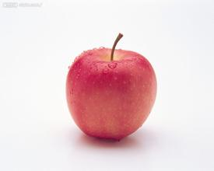
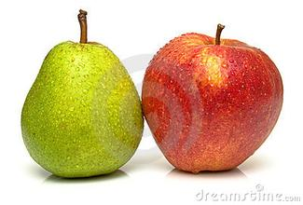
Example: optimal auction design
问题：在未知买家估值的情形下，
怎样出售商品，以最大化卖家收益？
问题难度与挑战
单个商品最优拍卖
Myerson拍卖（1981，Nobel prize 2007）
多个商品最优拍卖
未解决
进展
近似最优
[Li and Yao, PNAS-2013]
[Yao, SODA-2015]
[Yao, EC-2017]
精确最优
[Wang&Tang, ACM EC-2014] [Wang&Tang, IJCAI-2015]
[Tang&Wang, ACM EC-2016] [Tang&Wang, ACM EC-2016]
[Mirokni,Pas Leme, Tang, Zuo, IJCAI-16, EC-18, AAAI-19]
Notes:
Novel results and elegant analysis, the biggest breakthrough on approximation of optimal mechanism

Slide 18
Example: optimal auction design and application in advertising
最优拍卖理论（百度，腾讯，阿里，字节跳动）
[Shen & Tang AAMAS-2017]
GSP with Myerson reserves
Hybrid ranking
效果：减少广告，收益提升(10%)
上线（百度，字节跳动）
（动态）保留价
深度神经网络对广告主行为建模
强化机制设计
方法论：
Reinforcement mechanism design [Tang, IJCAI-17]
Reinforcement mechanism design in E-commerce [WWW-18, AAAI-18]
Reinforcement mechanism design in sharing economy [AAAI-19]

Slide 19
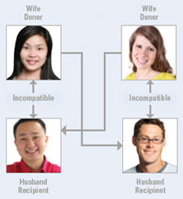
Example: kidney exchange

Slide 20
Kidney exchange
Motivation US nationwide kidney exchange system
A pair of (patient, donor) enters the system
Aiming for swapping kidneys with other pairs
If happens, win-win
Goal: Cycles, chains
UNOS, runs every two weeks, saves thousands lives
Main problem Market design at nationwide scale

Slide 21
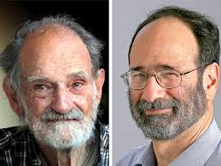
Kidney exchange
Representative work
College admission, stable marriage (Gale-Shapley ,Nobel prize 2012)
Kidney exchange mechanisms (Roth, Nobel 2012)
Clearing problem: find a set of disjoint cycles with length no greater than 3, that maximizes total weights, in weighted graph
NP complete [Abraham, Blum, Sandholm, EC-2007]
Integer programming formulation, column generation techs
Solve up to 10000 vertices in practice
Recently been approximately solved [Jia, Tang, Wang, Zhang AAMAS-17]
Our work on market design
Fair kidney exchange [AAMAS-2014]
Stable kidney exchange [AAAI-2014]
Multi-commodity exchange [AAMAS-2014,2015]
Lung exchange [IJCAI-2015, media paper]
Digital good exchange [AAMAS-2016, IJCAI-2016]
Water right market design [AAAI-16, AAMAS-17 best paper runner-up]

Slide 22
Summary
博弈与计算机科学的学科交叉
算法博弈论
多智能体系统
互联网经济学
分布式与区块链
人工智能与博弈的两大科研赛道
计算最优策略
棋牌游戏博弈，军事应用
设计最优机制
设计博弈机制，社会应用

Slide 23
谢谢大家！

