Slide 1
A Unified View of Multi-Label Performance Measures
Xi-Zhu Wu, Zhi-Hua Zhou
LAMDA Group, Nanjing University
Notes:
Thanks for introduction.

Slide 2
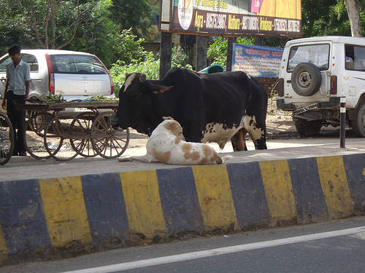
Multi-label classification
Multi-label classification deals with the problem where each instance is associated with multiple relevant labels.
Multi-class:
Multi-label:
Notes:
First, let’s see what is multi-label classification.
Multi-label classification deals with the problem where each instance is associated with multiple relevant labels.
For example, in multi-class problem, the first photo can be labeled as bicycle, and the second can be labeled as cow.
But in multi-label problem, they can have multiple labels, like car, dog, and so on.

Slide 3
Evaluation
Evaluation in multi-label classification is complicated.
Label:
Prediction A:
Prediction B:
Notes:
The evaluation in multi-label classification is a bit complicated.
For example, the two pictures. Suppose we now have two predictions, prediction A and prediction B. Which is better?
In terms of correct predictions, we find that A has four correct predictions, more than B. So prediction A seems to be better. But if we care about the incorrect predictions, B has less incorrect predictions which means B is better.

Slide 4
Performance measures
Multi-label performance measures:
Hamming loss
ranking loss
one-error
coverage
average precision
macro-F1
micro-F1
instance-F1
macro-AUC
micro-AUC
instance-AUC
…
Notes:
Multi-label evaluation is complicated, that’s why so many performance measures are proposed. You can see there are many performance measures in multi-label.

Slide 5
Multi-label algorithmic works
"My algorithm is better!" See experimental results in these measures…
Algorithm | Performance measures used
LIFT | hloss, one-error, coverage, rloss, avgprec, macro-AUC
ML-kNN | hloss, one-error, coverage, rloss, avgprec
MAHR | hloss, one-error, coverage, rloss, avgprec
LEAD | hloss, one-error, coverage, rloss, avgprec
LMCF | hloss, one-error, rloss, avgprec
Rank-SVM | hloss, rloss, precision, one-error
ECC | hloss, macro-F1, macro-AUC
COMB | micro-F1, macro-F1
LM-kNN | micro-F1, instance-F1
BSVM | micro-F1, macro-F1
RAkEL | hloss, micro-F1
CPLST | hloss
Notes:
In previous works, when a new multi-label algorithm is proposed, the most common way to prove the superiority is to show the experimental results in different measures. However, there are so many performance measures, and they can only post the results on some of them.

Slide 6
Motivation
The phenomenon:
BSVM performs well on micro-F1/macro-F1 on datasets called scene and yeast. [Fan and Lin, 2007]
BSVM performs poor on coverage/ranking loss on these same datasets. [Zhang and Wu, 2015]
The question: is there any relationship between measures?
well on measure A $≈$well on measure B ？
well on measure A $≈$bad on measure B ？
To answer: we need a unified view to analyze many measures at once to reveal the relationship between them.
—— label-wise margin/instance-wise margin
Notes:
Meanwhile, we have found this phenomenon that one algorithm performs well on some performance measures may be poor on other measures.
So, how to explain the phenomenon. Is it possible that if we do well on measure A, we will also do well on measure B? Or, is it possible if we do well on measure A, the performance on measure B becomes worse
To answer this question, we need a unified view to analyze many measures at once to reveal the relationship between them. We proposed two new concepts called label-wise margin and instance-wise margin as tools to analyze them.

Slide 7
Notations
Instance matrix:
Label matrix:
Predictor: ,
Label matrix
Prediction
$$x_{1}$$ | 1 | 0 | 0
$$x_{2}$$ | 1 | 1 | 0
$$x_{3}$$ | 0 | 0 | 1
0.9 | 0.3 | 0.1
0.8 | 0.9 | 0.2
0.7 | 0.8 | 0.7
Notes:
Here we introduce some notations. The instance matrix is X, with m instances. And the label matrix is Y, with m instances and l labels. And the real-value predictor F, which can be decomposed into f1 to fl.
For example, there is a label matrix Y and the according prediction matrix F(X).
The 1 in label matrix means the positive label, and zero means negative label. We want the predictions higher on positive label and lower on negative label.

Slide 8
Label-wise/instance-wise margin
Margin: the minimum difference between the predictions of a positive and a negative label.
Label-wise margin:
Label matrix
Prediction
Label-wise margin
1 | 0 | 0
1 | 1 | 0
0 | 0 | 1
0.9 | 0.3 | 0.1
0.8 | 0.9 | 0.4
0.7 | 0.9 | 0.7
0.6
0.4
-0.2
Notes:
Here comes the definition of our two concepts, label-wise margin and instance-wise margin.
First, Margin is the minimum difference between the predictions of a positive and a negative label
Label-wise margin is the margin defined on each instance, between positive and negative labels.
For example, on the label matrix and the according prediction matrix, the minimum difference on the first instance is between 0.9 and 0.3

Slide 9
Label-wise/instance-wise margin
Margin: the minimum difference between the predictions of a positive and a negative label.
Label-wise margin:
Instance-wise margin:
Label matrix
Prediction
Label-wise margin
1 | 0 | 0
1 | 1 | 0
0 | 0 | 1
0.9 | 0.3 | 0.1
0.8 | 0.9 | 0.4
0.7 | 0.9 | 0.7
0.6
0.4
-0.2
0.1 | 0.0 | 0.3
Instance-wise margin
Notes:
Similarly, we define the instance-wise margin. On the first label, the minimum difference is between 0.8 and 0.7, so the instance-wise margin on the first label is 0.1
That’s the definition of label-wise and instance-wise margin

Slide 10
A prediction function F can:
Optimize label-wise margin
Optimize inst-wise margin
Optimize double margin
Notes:
Now, by the definition of the two margins, a prediction function F can optimize the label-wise margin, or optimize the instance-wise margin. Furthermore, it can optimize double margin, which means optimize both the two margins.

Slide 11
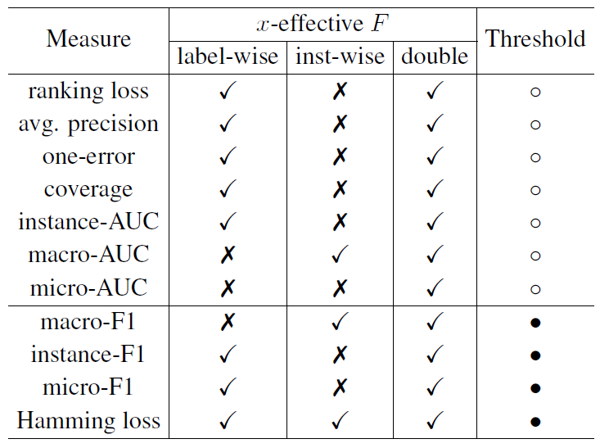
The main results
By optimizing different margins, according measures are to be optimized.
‘✔’ means $F$ in this cell is proved to optimize this measure;
‘✘’ means $F$ in this cell does not necessarily optimize the measure;
‘●’/‘○’ means the calculation is with/without thresholding.
similar
different
Notes:
Here is our main results. We prove that by optimizing different margins, according measures are to be optimized.
From the table, we can see some performance measures are closely related
The detailed discussion of thresholding can be found in our paper

Slide 12
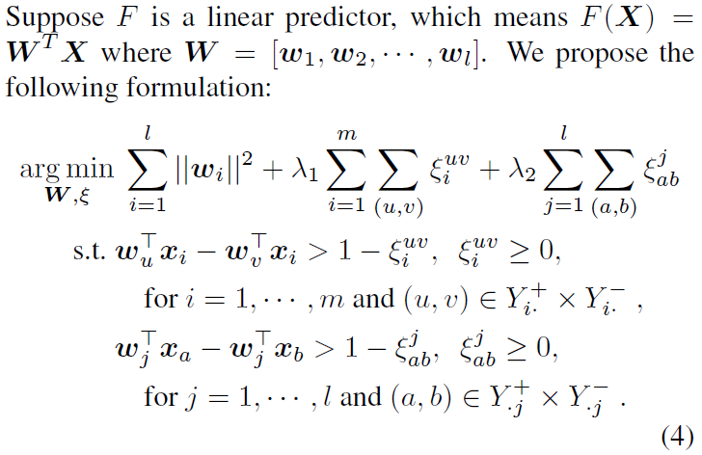
Validate the theoretical results
Optimizing each/both margins proved to have different results on different measures
The results are true in practice?
Definition -> Formulation -> Algorithm -> Experiments
Formulation:
Loss on label-wise margins
Loss on
instance-wise margins

Slide 13
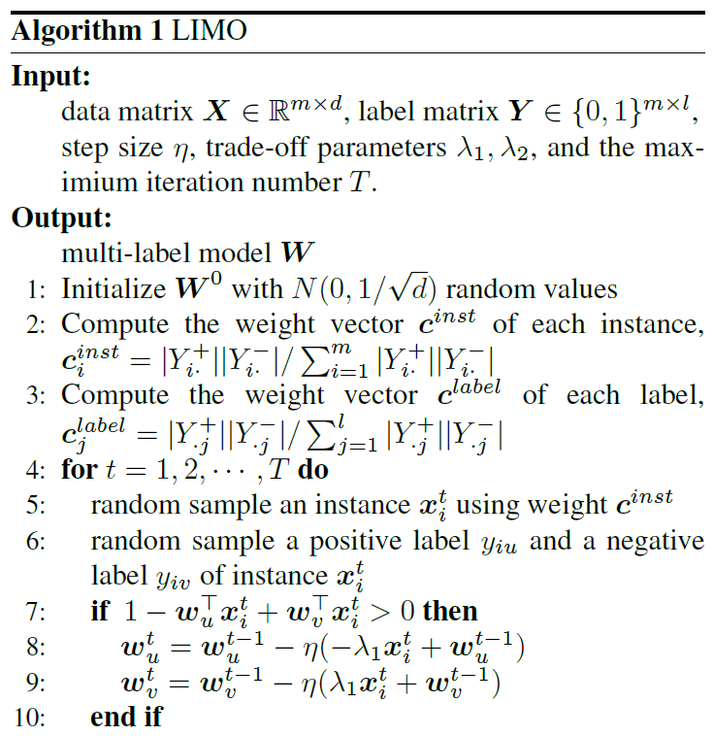
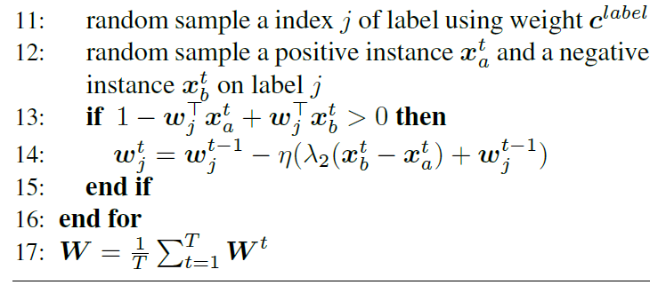
LIMO (Label-wise and Instance-wise Margin Optimization)
SGD
optimize instance-wise margins
optimize label-wise margins
Notes:
In each iteration, the algorithm random pick some instances and labels to optimize the two margins

Slide 14
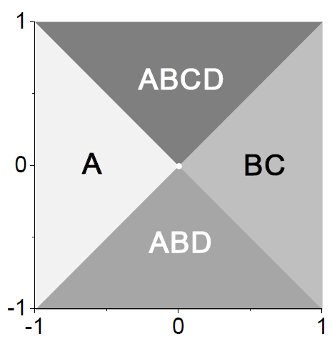
Experiments - synthetic
The synthetic data
4 labels
On [-1,1] square
Comparison:
LIMO-label
LIMO-inst
LIMO
LIMO
LIMO-label
LIMO-inst
Notes:
For LIMO-label, we set lambda_2=0 and only keep the second term (loss on label-wise margin)

Slide 15
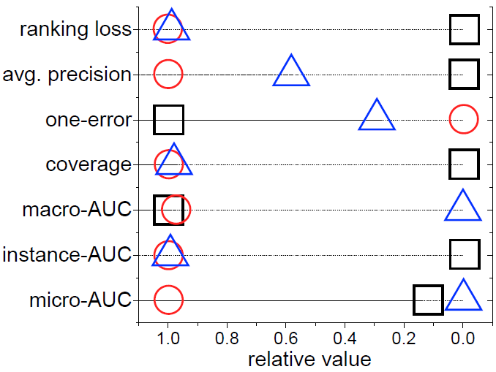
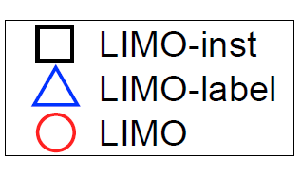
Experimental results
Rescale to [0,1], higher are better

Slide 16
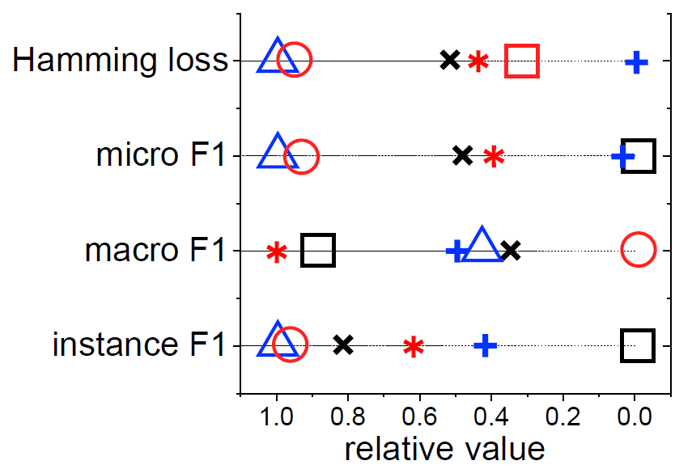
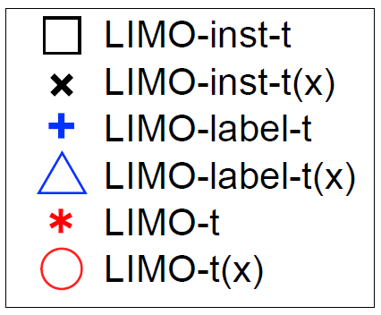
Experimental results – cont’d

Slide 17
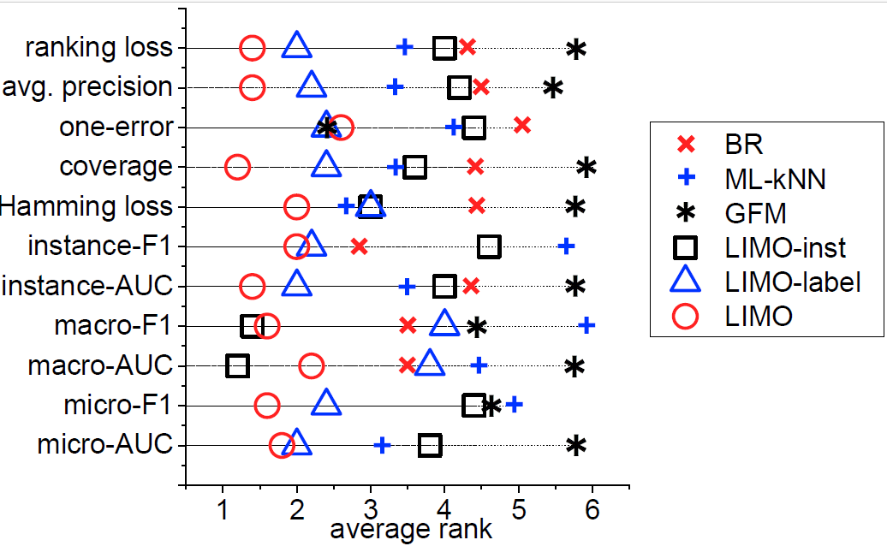
Experimental results on benchmark
Consistent!
Datasets:
CAL500, enron, medical, corel5k, bibtex
Notes:
The experimental results are consistent with theoretical results

Slide 18
Experiments - benchmark
Datasets
CAL500, enron, medical, corel5k, bibtex
Comparison:
LIMO
LIMO-label
LIMO-inst
BRSVM
ML-kNN
GFM
http://mulan.sourceforge.net/datasets-mlc.html

Slide 19
Conclusion
Evaluation is complicated in MLC
Too many performance measures
Contribution: A unified view of measures, which provides better understanding of MLC evaluation
Take-home table:

Slide 20
Thanks!
Poster #139 tonight
wuxz@lamda.nju.edu.cn
Code: https://github.com/YuriWu/LIMO
Notes:
I’m happy to take questions

