Slide 1
DualSMC: Tunneling Differentiable Filtering and Planning under Continuous POMDPs
IJCAI' 2020 孔祥瀚

Slide 2
Sampling-based方法的局限性
处理dynamic未知的POMDP问题
处理复杂观测如图像输入的问题
本文了结合sampling-based方法的效率和可解释性与深度学习的灵活性
model-based RL+model-free RL

Slide 3
Planning as Probabilistic Inference
control as (probabilistic) inference
我们选择Ot的概率分布为：
Reinforcement Learning and Control as Probabilistic Inference: Tutorial and Review (Sergey Levine)

Slide 4
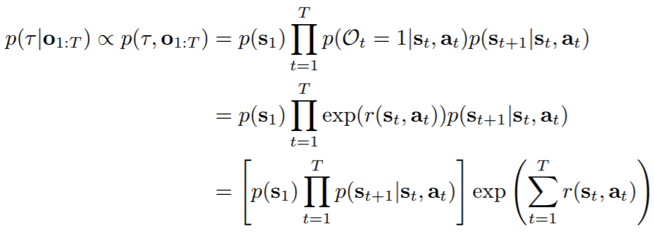
Planning as Probabilistic Inference
最优轨迹的后验概率：
固定轨迹概率，总奖励越大，轨迹的后验概率越大
这样我们就可以用推断算法来解决控制和规划问题
轨迹概率 × exp(奖励求和)

Slide 5
Planning as Probabilistic Inference
inference：给定evidence求其余未知量的后验
evidence：
待求的后验：
backward message
policy

Slide 6
Planning as Probabilistic Inference
back message 和 value function
policy
与max entropy下的值函数是等价的

Slide 7
SMC Planning
Sequential Monte Carlo（SMC）== Particle Filter (PF)
bayesian 平滑
back message
SMC更新
Probabilistic Planning with Sequential Monte Carlo methods(ICLR2019)

Slide 8
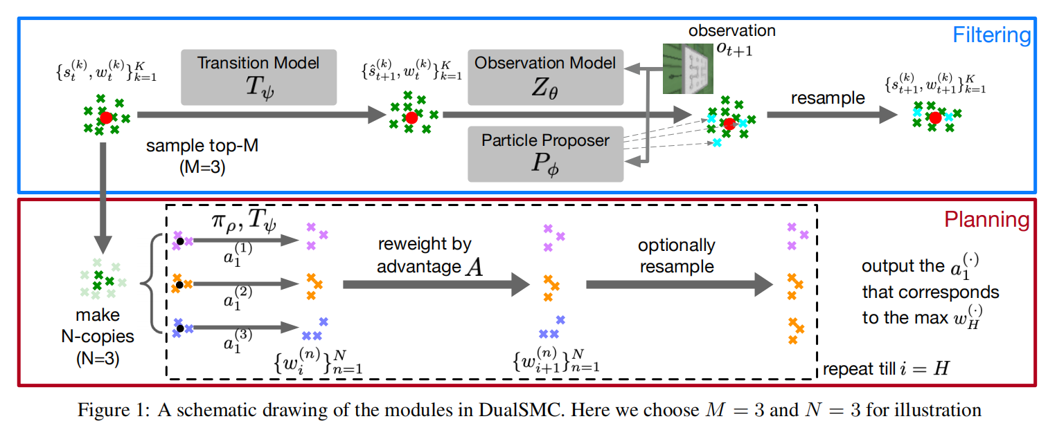
DualSMC
differentiable particle filter：
proposer transition observation

Slide 9
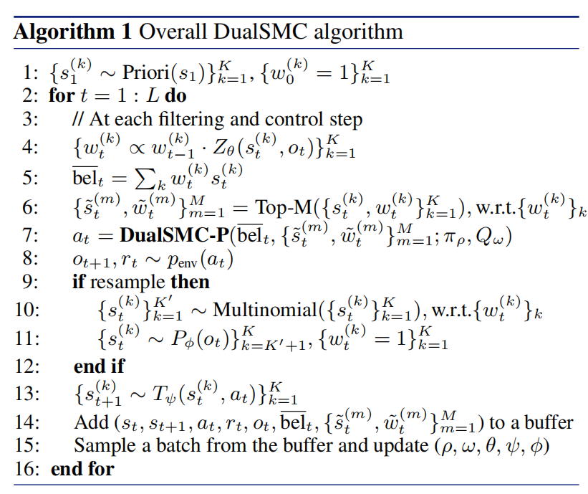
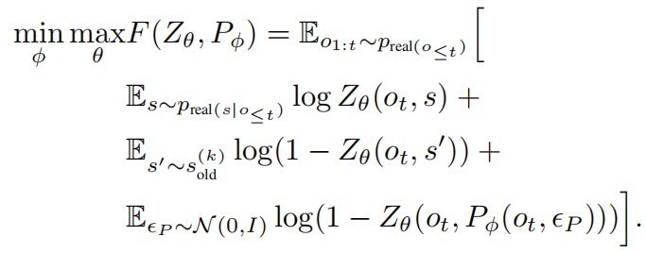
DualSMC算法
proposer 和observation model 看做生成对抗的两个网络， 区分所有粒子状态中的真实状态， 来混淆它。

Slide 10
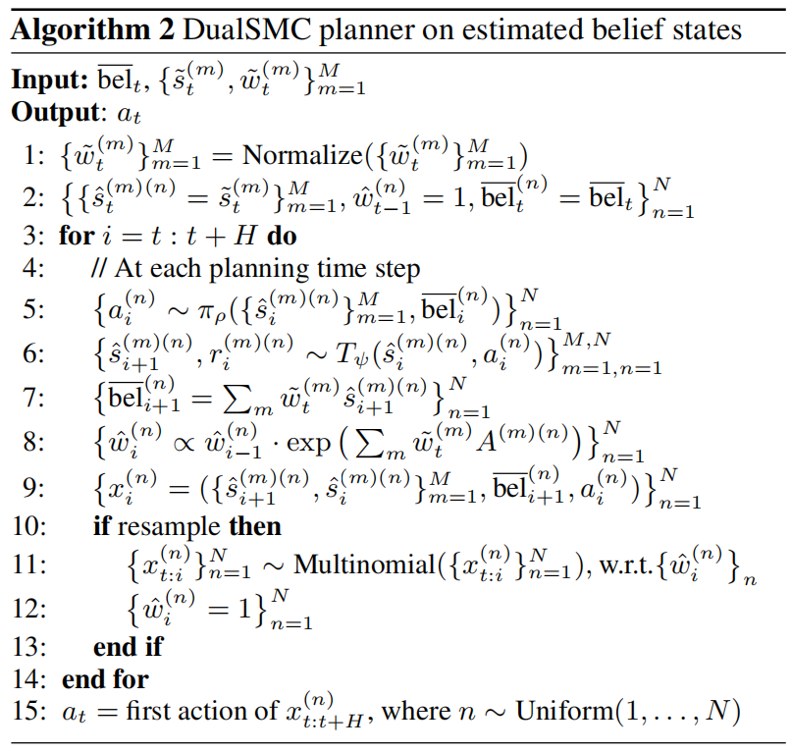
DualSMC规划算法
Particle-Independent SMC Plannning
不能基于动态变化的状态不确定性生成策略
作为实验的baseline
DualSMC

Slide 11
Experiment
2D Floor Positioning
3D Light-Dark Navigation
Modified Reacher

Slide 12
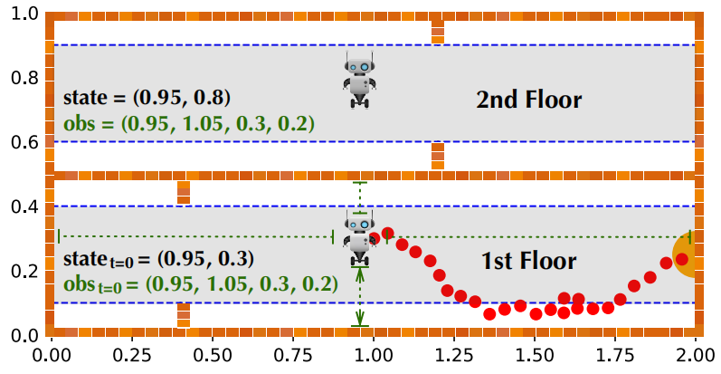
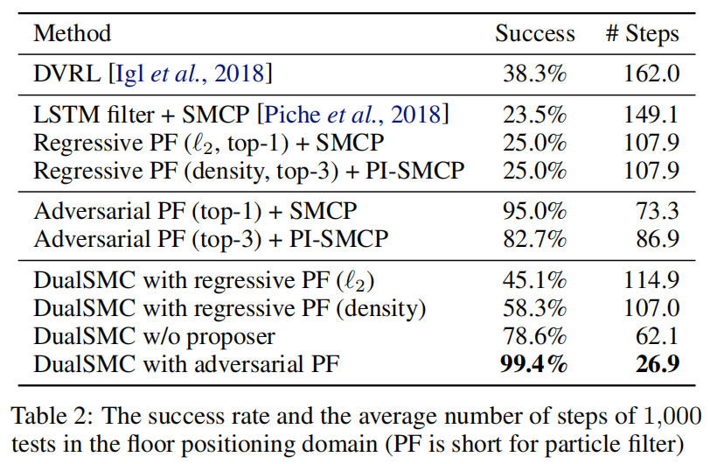
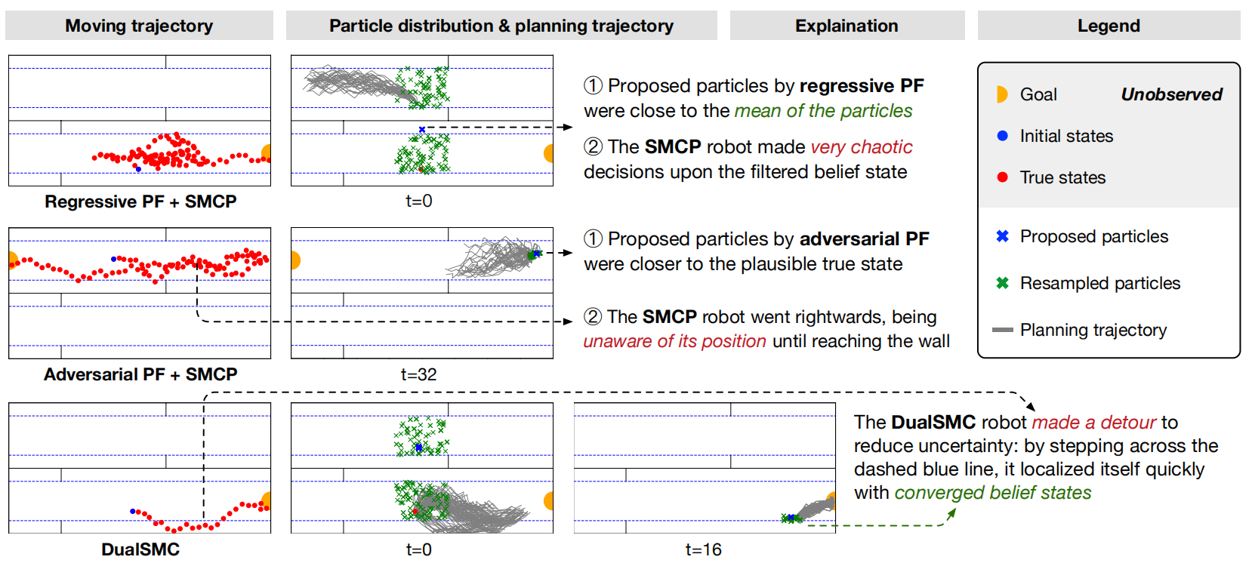
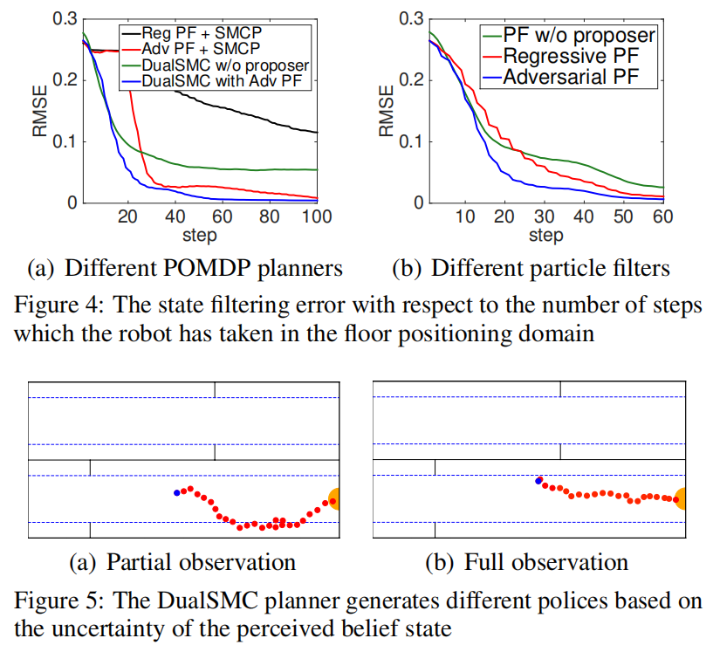
2D Floor Positioning

Slide 13
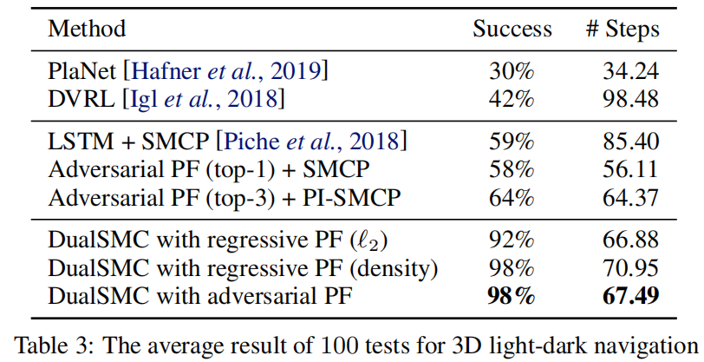
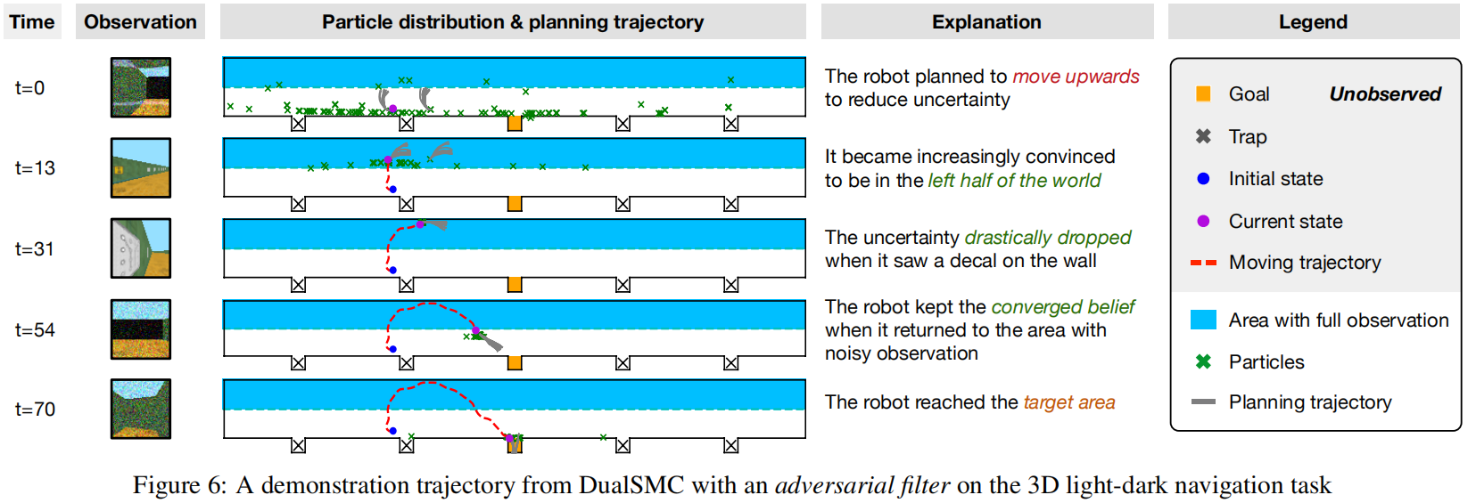
3D Light-Dark Navigation

Slide 14
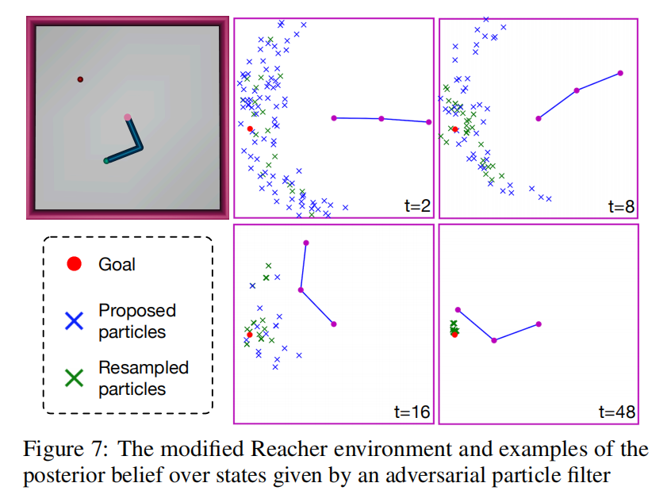
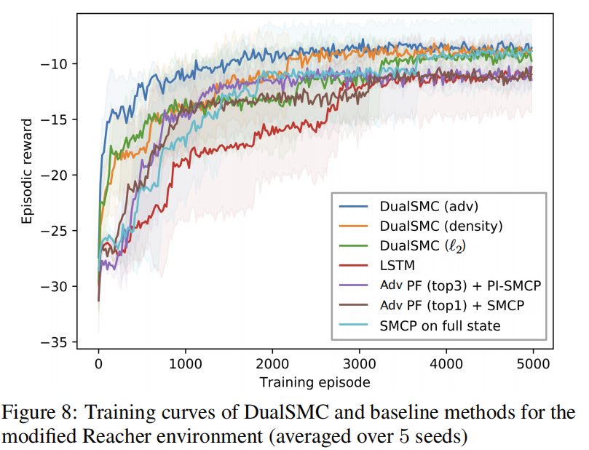
Modified Reacher

Slide 15
Thanks

