Slide 1
Dive into DPF&DPFRL
Presented by Wei-jian Liao

Slide 2
What we gonna talk about…
Differentiable Particle Filter (DPF)
Focus on how to do better state estimation
Re-implement particle filter algorithm in differentiable programming way
Discriminative Particle Filter Reinforcement learning (DPFRL)
Based on differential particle filter
Core idea is how to connect the upstream state estimation task and downstream decision task

Slide 3
What we gonna talk about…
Theme
Differentiable Particle Filter
Discriminative Particle Filter Reinforcement learning
Details
Method details
Implementation details
Experiment details

Slide 4
Particle Filter
observation
resample
transition
…

Slide 5
Differentiable Particle Filter
Motion Model:
i^{th} particle in timestep t-1
Transition function(learned or predefined)
Observation likelihood function:
Embedding of observation
(optional) Particle Proposer:
Just dropout trick，nothing else

Slide 6
Differentiable Particle Filter
Realize such series of models using supervised learning!
Learn motion model:
With superscript “*” means true state
Learn observation likelihood function(measurement):
Learn motion and measurement model together(fully end2end):
Belief at true state estimated as mixture Gaussian distribution w.r.t distance between particles and true state

Slide 7
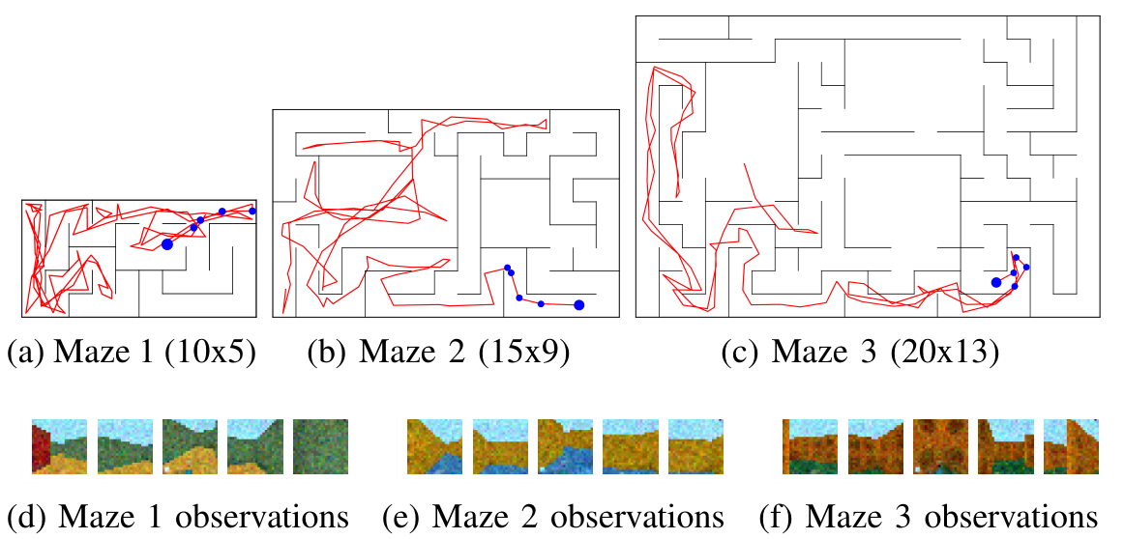
Differentiable Particle Filter
Global Localization Task

Slide 8
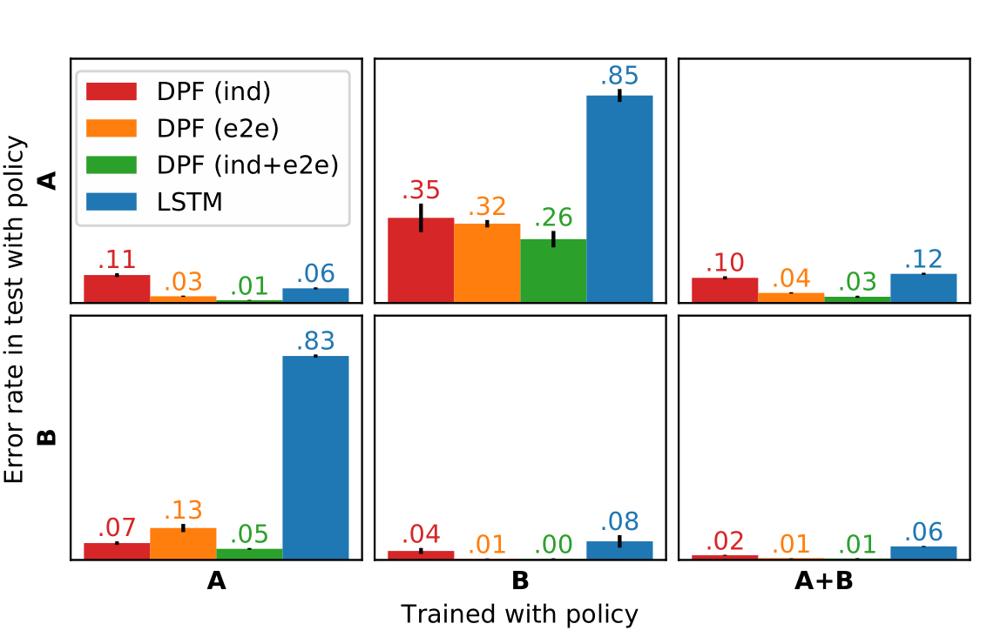
Differentiable Particle Filter
What is Error here: a prediction erroneous if the distance to the true state, divided by is a scale $E_{t}[\text{abs}(s_{t}−s_{t−1})]$, greater than 1.
Policy A: heuristic exploration policy
Policy B: uses the true pose of the robot, randomly generates a goal cell in the maze, computes the shortest path to the goal, and follows this path from cell to cell with some randomness

Slide 9
Differentiable Particle Filter
May be a big inspiration or demonstration for transfer learning under POMDP !
Policy-invariant state estimation method really matters.

Slide 10
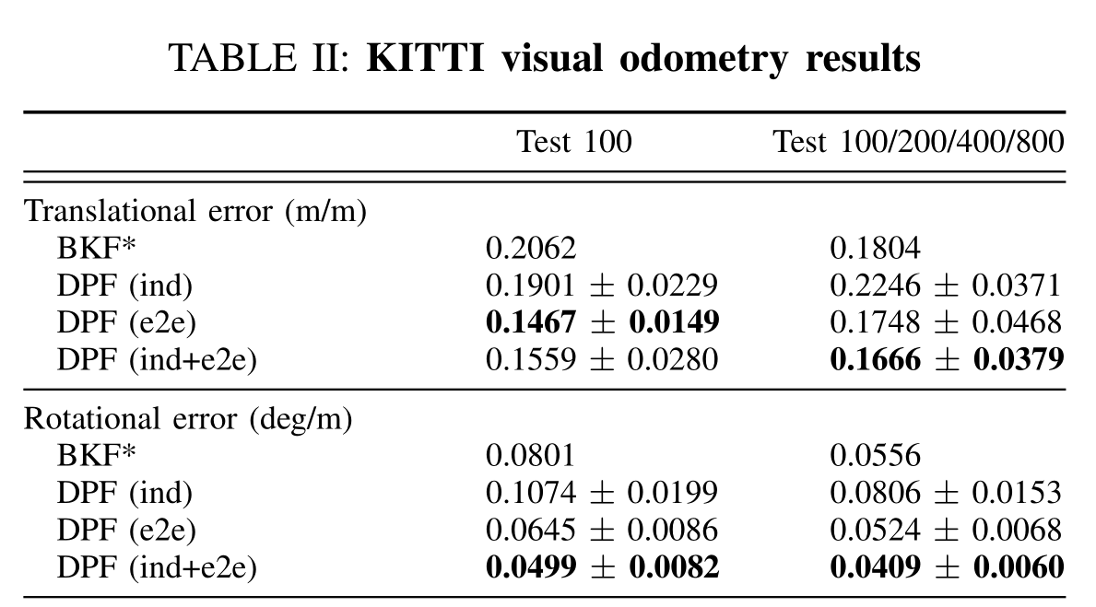
Differentiable Particle Filter
Backprop Kalman filter vs. DPF

Slide 11
Differentiable Particle Filter
What’s the next ?
now is Supervised Learning
Is Unsupervised possible?
Some work already on the way…
Some work already on the way…
Wen, H., Chen, X., Papagiannis, G., Hu, C., & Li, Y. (2020). End-To-End Semi-supervised Learning for Differentiable Particle Filters. ArXiv, abs/2011.05748.
Wen, H., Chen, X., Papagiannis, G., Hu, C., & Li, Y. (2020). End-To-End Semi-supervised Learning for Differentiable Particle Filters. ArXiv, abs/2011.05748.

Slide 12
Discriminative Particle Filter RL
Regular form:
State estimation part
Discriminative Particle Filter:

Slide 13
Discriminative Particle Filter RL
f_{trans} Implementation based GRU architecture:
Where,
f_{obs} simply use one fully-connected layer:

Slide 14
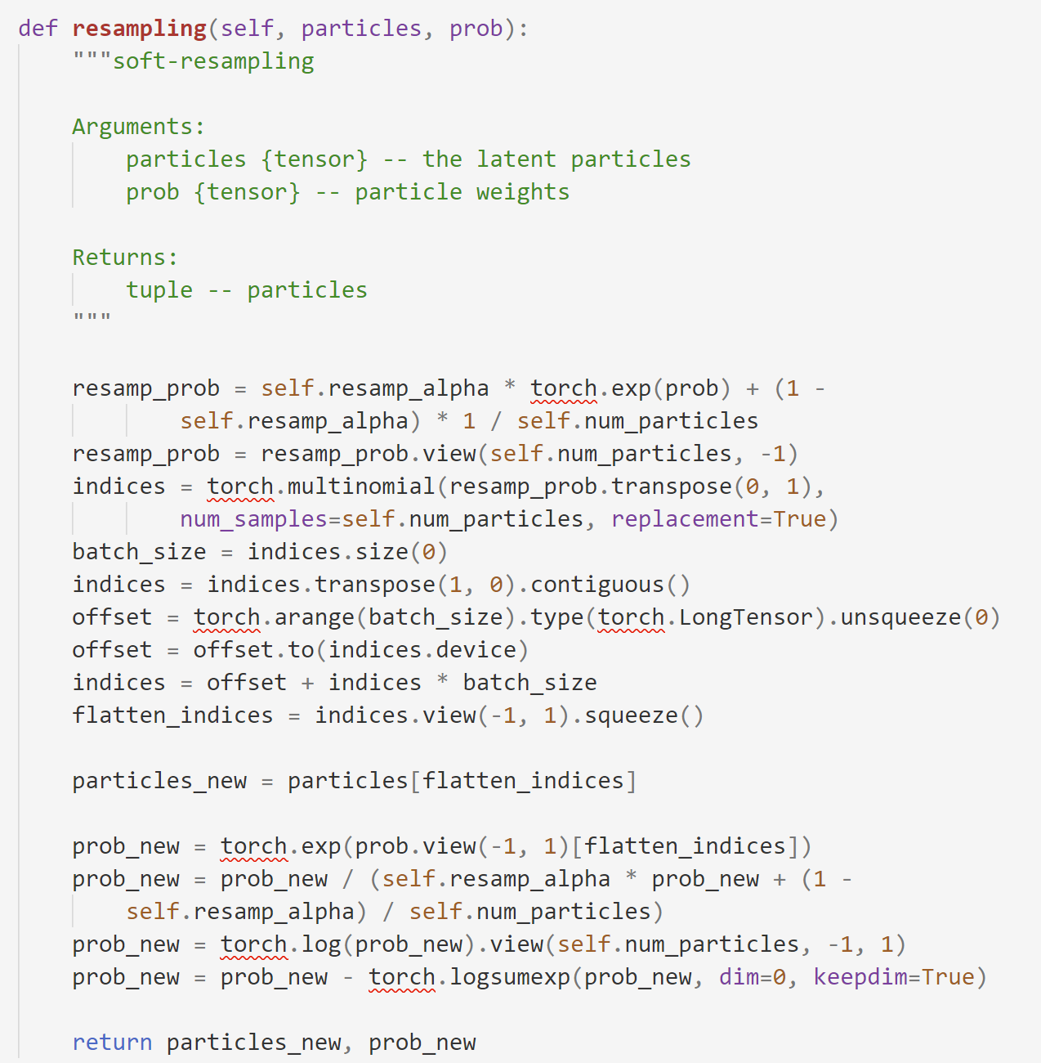
Discriminative Particle Filter RL
Soft-resampling:
Previous work encountered obstacles here because after resample the weight of new particles is directly set to a constant which stop the gradient backprop;
In this work, they use a softened proposal distribution, and sample from this. So the weight becomes:

Slide 15
Discriminative Particle Filter RL
Decision part
Just applied A2C to learn Policy p(a|b_{t}) and Value V(b_{t})
Problem here is how to represent b_{t} ?
In this paper, they do as,
Weighted average of h
M MGF features
Regard as belief summary

Slide 16
Discriminative Particle Filter RL
Moment Generation Function
This function contains any-order moment of a distribution.
If such function converges, it can fully described the corre-sponding distribution.

Slide 17
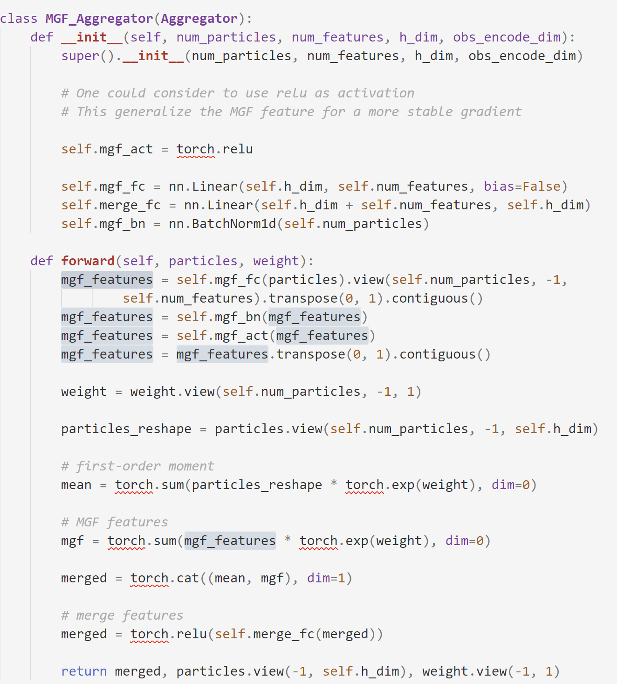
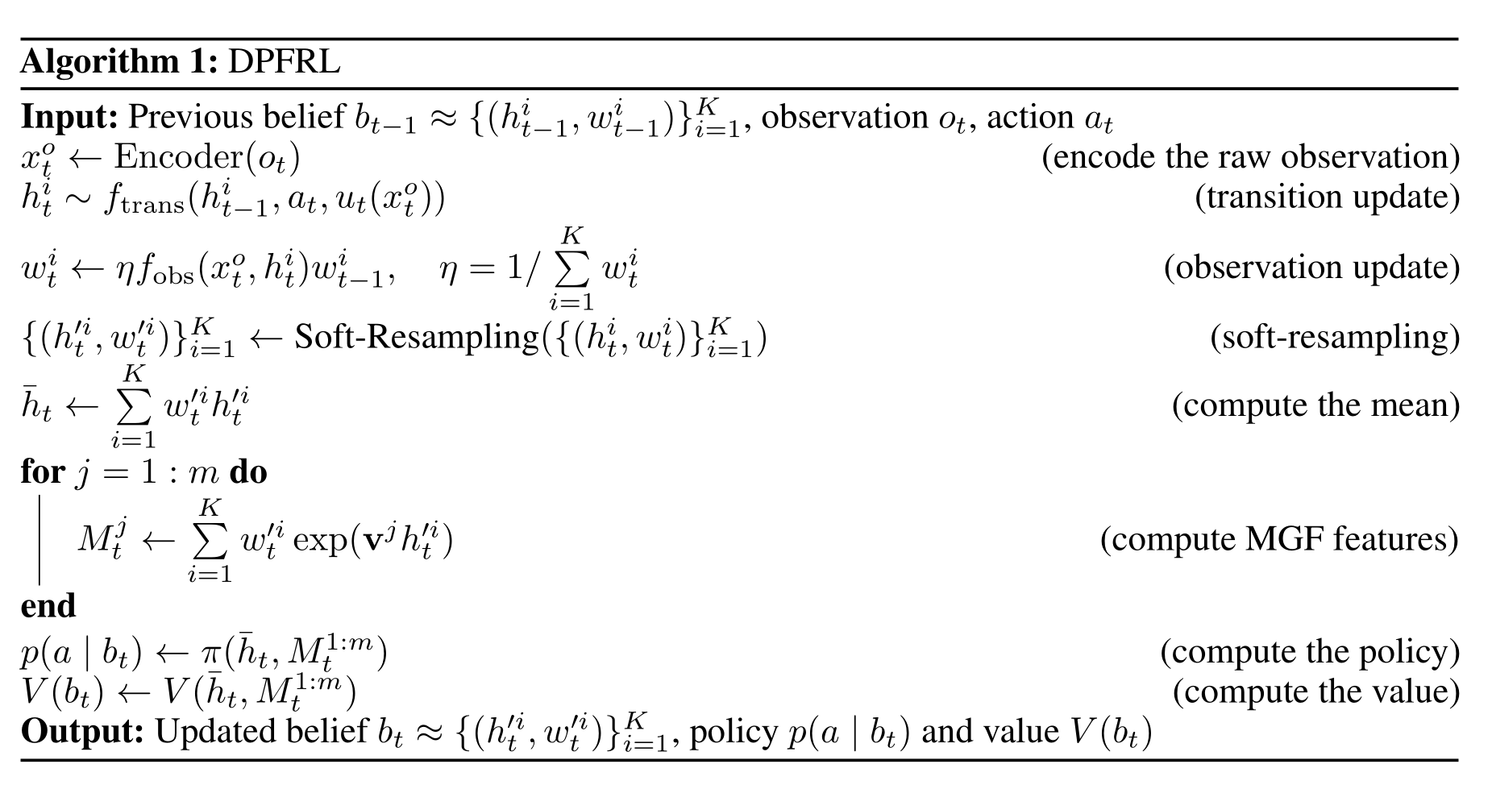
Discriminative Particle Filter RL
Implementation in this paper:

Slide 18
Discriminative Particle Filter RL
Experiment Environment
Mountain Hike: navigate along a mountain ridge by receiving noisy measure of current location
Natural Flickering Atari: partial observability simulated by flickering frames, and complex observations simulated by random background videos
Visual Navigation: receives first-person RGB-D camera image and its distance and relative orientation to the goal
Three kinds of PO-environments: observation with noise/observation is a subset of true state/observation and true state from different mode

Slide 19
Discriminative Particle Filter RL

Slide 20
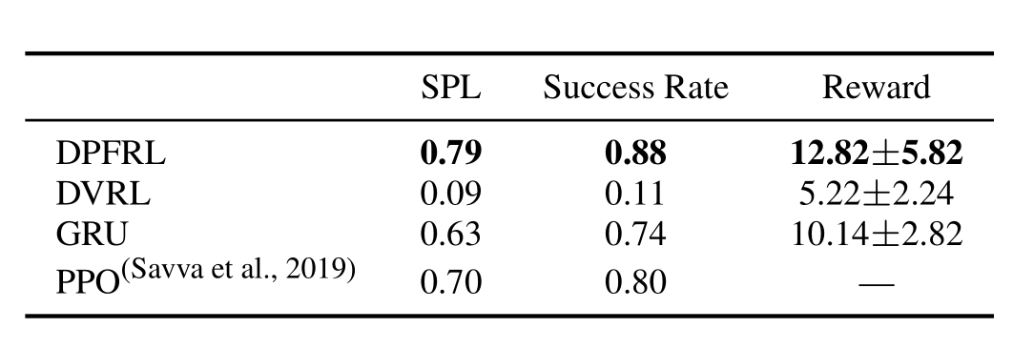
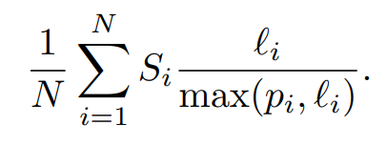
Discriminative Particle Filter RL
Success weighted by path length
l: actual path length
p: ideal shortest path length
s: reach the goal or not
DPFRL is robust to noisy input/can learn a more powerful latent belief than other methods
Irrelevant features from ob harm the performance
More and more reduce into visual problem😂

Slide 21
Take Home Message
We can do a pretty good state estimation in learning way now, showed by DPF
Deep learning method based on explicit belief modeling can be a better alternative for agent acting under POMDP

Slide 22
Thanks!

